Slide 1
Obtaining the Target Star
How to get to the right place
at the right time
Jacquie Milner
18th April 2014
Workshop on Occultation Timing
NACAA XXVI
Notes:
A regularly occurring reason for not observing an occultation is that the observer could not find the target star in time. This presentation is aimed at providing a variety of methods that the observer can chose from to make this task easier and more reliable, plus a little trap to look out for.

Slide 2
Coordinate information:
Why?
The target star is often around magnitude 10 to 12, which is below the level of most commercially printed charts for visual observing
There are millions of stars out there and you need to be sure you’re looking at the right one
Where is it?
Notes:
So we can find the particular star that is being targeted for an event we need to know its individual coordinates. The stars that are occulted are rarely bright naked-eye stars. They typically in the range of magnitude 9.0 to 13.0 (your range may vary depending on your aperture.), so they are “faint” and you are unlikely to find them on a commercially produced chart such, as Sky Atlas 2000.

Slide 3
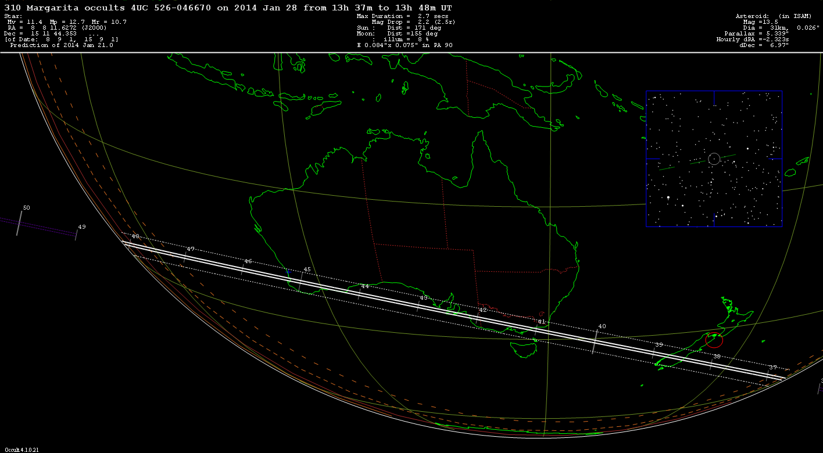
World map generated by Occult
Notes:
The coordinate information for the target star is given in the top left corner of the world map generated by Occult. These maps are often provided by the Occultation Section or if you have generated your own prediction in Occult double-click on the prediction line to bring this map up. A close up of the coordinate information provided for the target star: Note that it is in J2000 epoch, which is the current standard epoch. Regarding whether the Declination is north or south of the celestial equator, north does not have a “+” sign but a southern declination will have a “-“ sign. In this example the star is north of the equator.

Slide 4
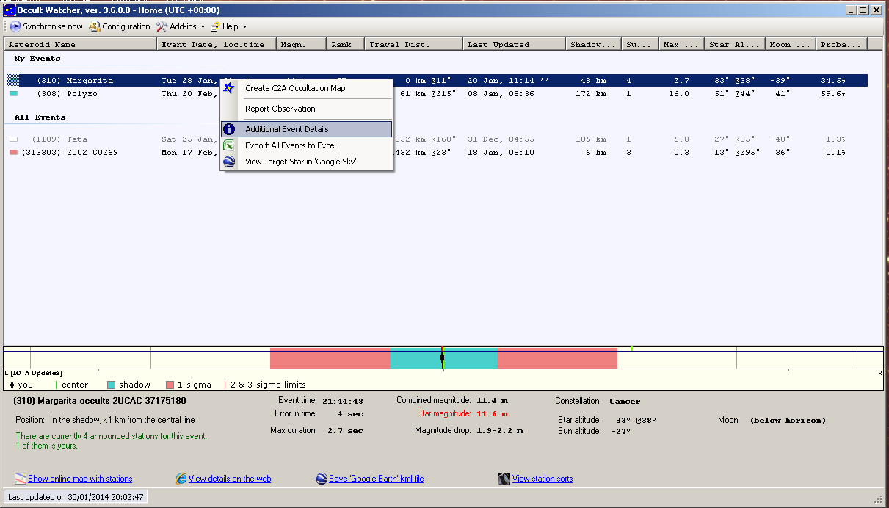
OccultWatcher: right click on event
Notes:
Occultwatcher provides all the details you need as well and you can access this by right-clicking on the event line and choosing “Additional Event Details.”

Slide 5
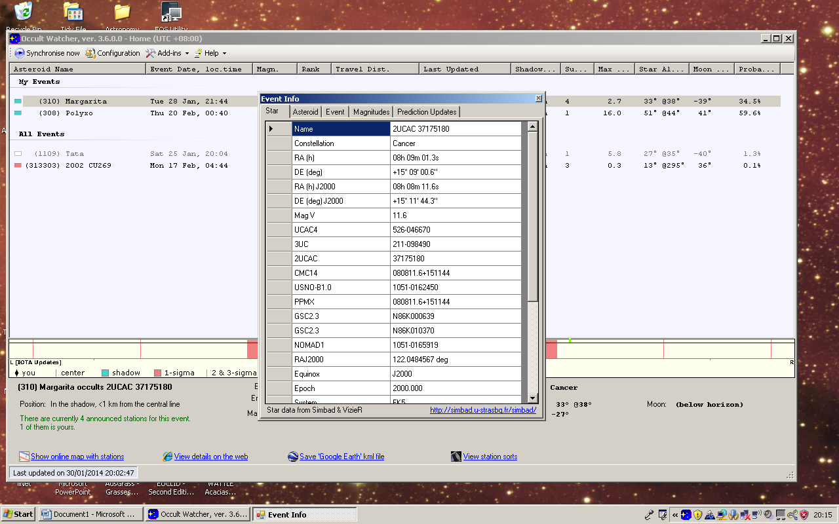
Notes:
This opens a box with several tabs at the top. The first tab should have the data for the target star. Use the J2000 coordinates, or alternatively you can see a range of alternative catalogue numbers that you may be able to apply.

Slide 6
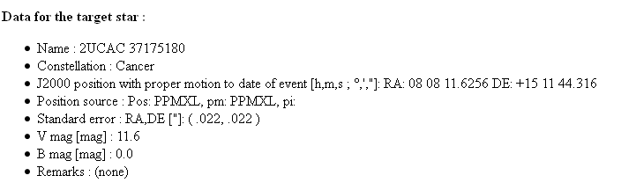
Occultation section pages
Notes:
If a page for the event is provided on the RASNZ Occultation Section website then the information is repeated half way down the page.

Slide 7
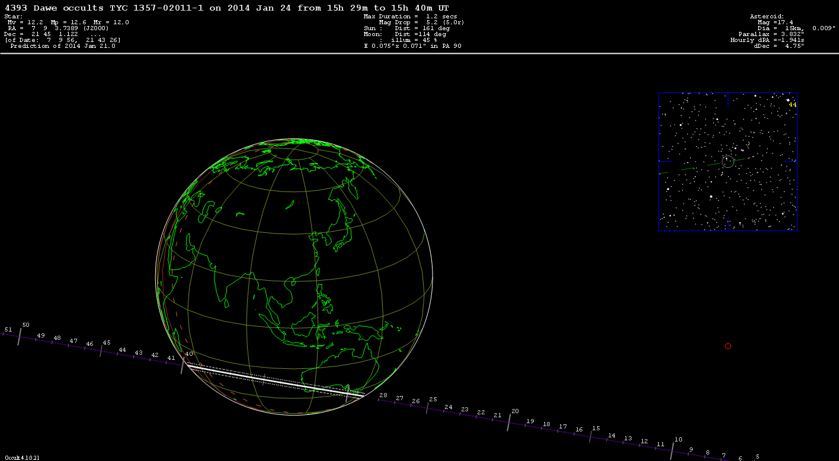
Star Catalogs used
4UC = 4UCAC
TYC = Tycho
HIP = Hipparcos
Notes:
Three star catalogues are typically used for current predictions: 4UCAC, the Tycho (TYC) catalogue and occasionally the Hipparcos (HIP) catalogue.

Slide 8
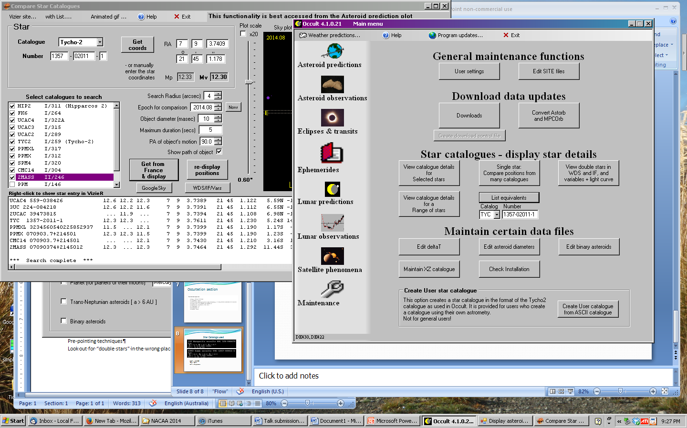
Assistance in Occult
Notes:
If you don’t have OccultWatcher handy there is assistance in Occult to find out what the star is known as in other catalogues. In the middle of the General Maintenance Functions page there is a button for “List Equivalents.” After entering a star it should open another box with equivalent catalogue names as well as the coordinates.

Slide 9
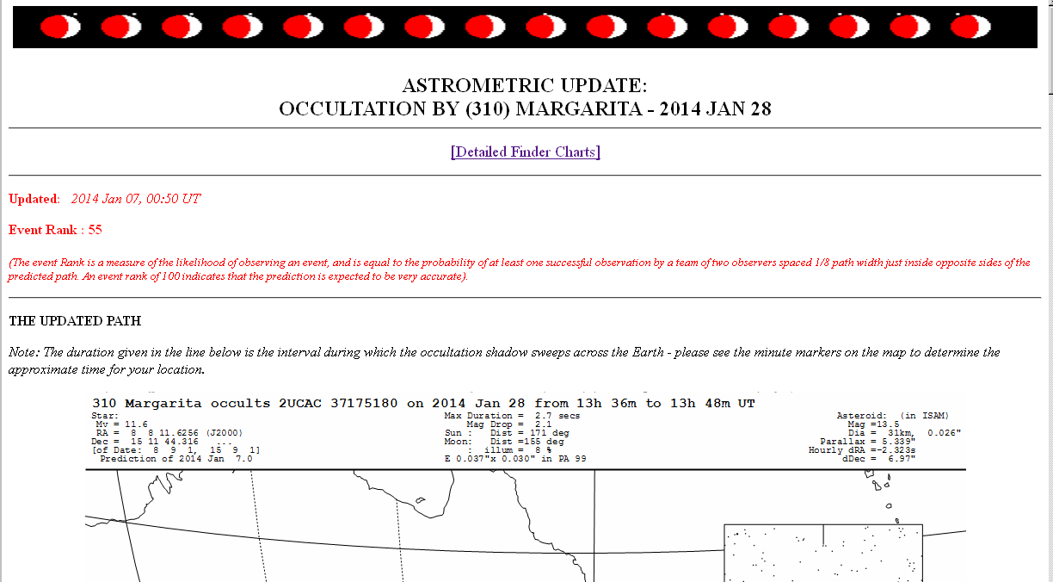
Star Charts: Occultation Section website
Notes:
Once you have the coordinates of your star you are now ready to prepare some star charts. There are several places to find them or you can make your own. Firstly, on the RASNZ Occultation Section website there is a link to the finder charts at the top of the page.

Slide 10
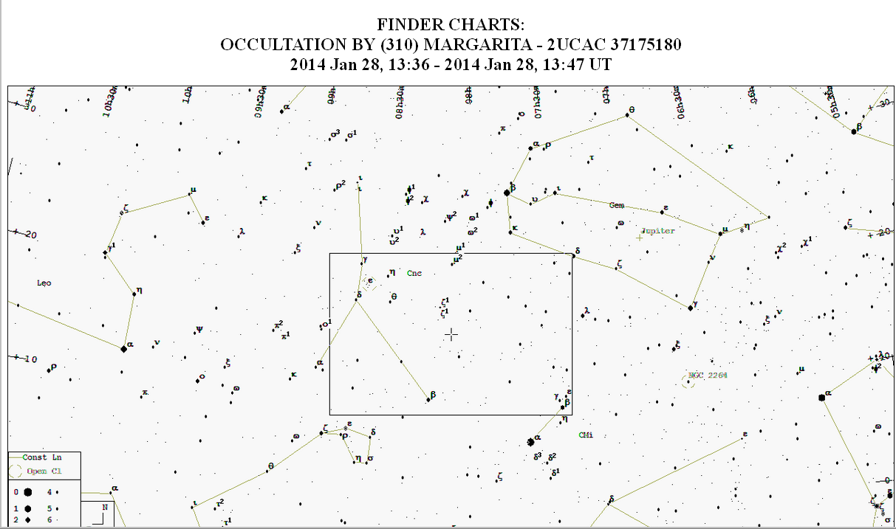
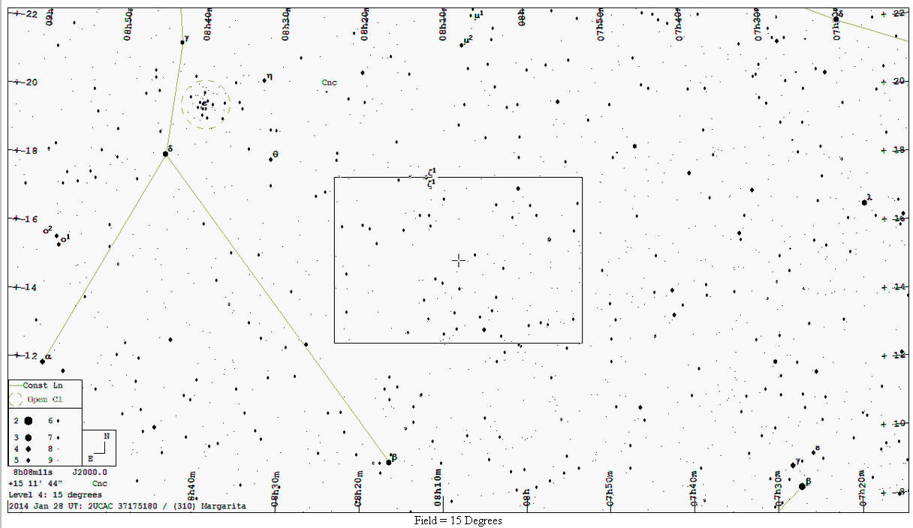
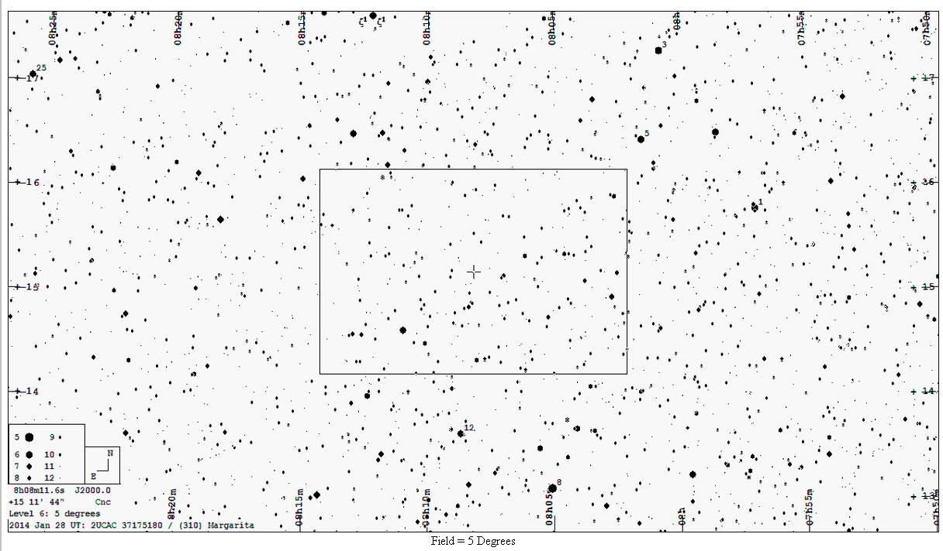
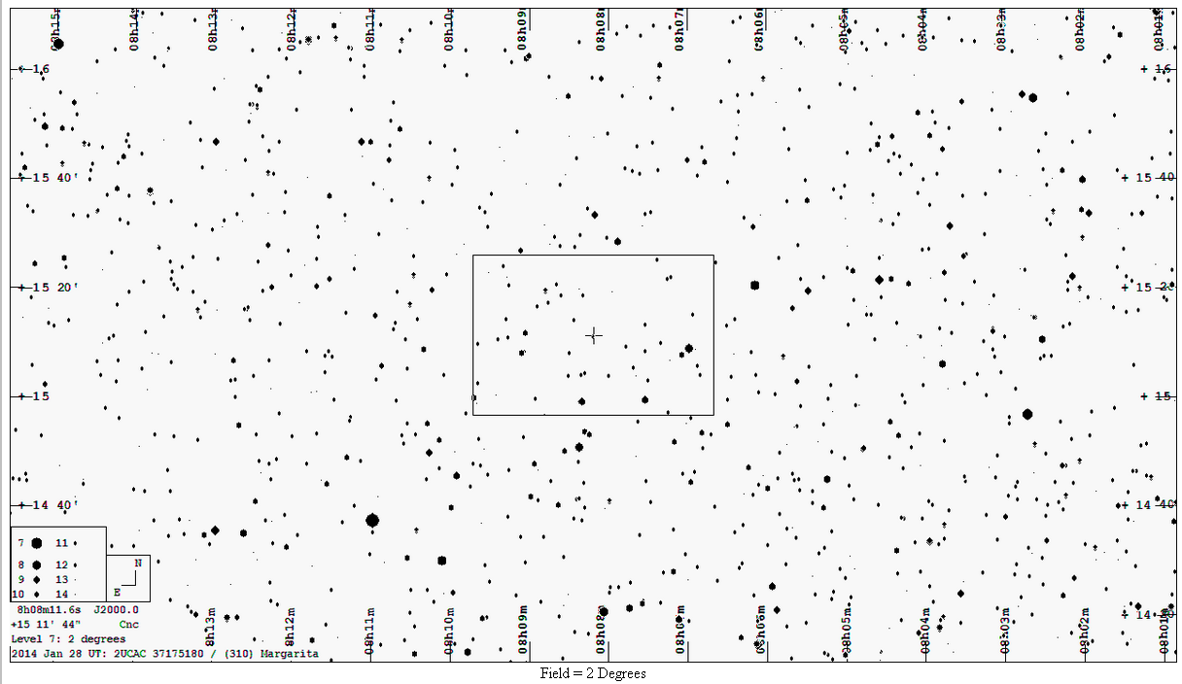

Notes:
This should take you to a series of charts from a wide-field 45 degrees down to a field 30 minutes wide.

Slide 11
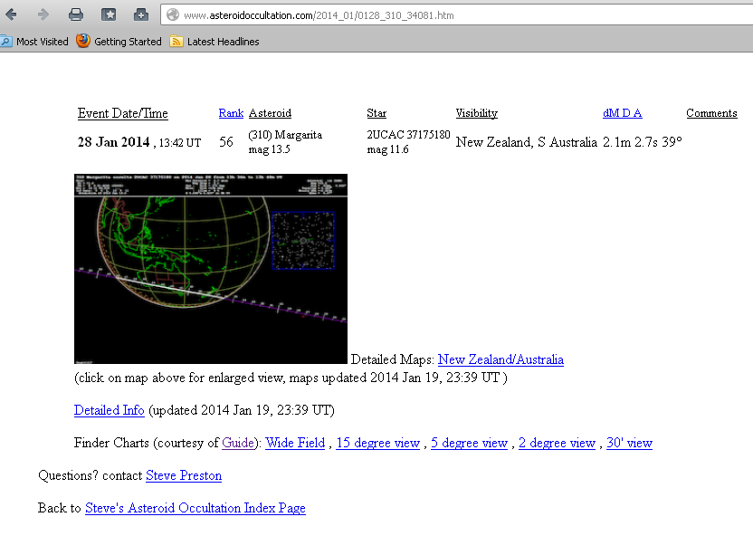
Steve Preston’s website www.asteroidoccultation.com
Notes:
If you go to Steve Preston’s site you should be able to find the same series of charts.

Slide 12
Make your own!
How many levels do you need?
  An overview of the surrounding constellations
  One about twice the field of view of the camera
  As many as you like in between depending on your method
Set your limiting magnitude to two magnitudes fainter than your observing limit.
Notes:
Or you could make your own!
At a minimum I recommend two charts, one widefield showing the surrounding constellations so you can find the nearest bright star, and a one about twice the width of your field of view in through the camera (eg. 30 minutes) so you can see some of the surrounding stars.
Set the magnitude limit about 2 magnitudes below your target star. You will find that this will show enough stars to confirm where you are without crowding the page.
If you don’t own any charting software you can use the C2A star atlas plug-in that is available through Occultwatcher. Guide 9, from Project Pluto, is used to generate the charts you find on the occultation websites.

Slide 13
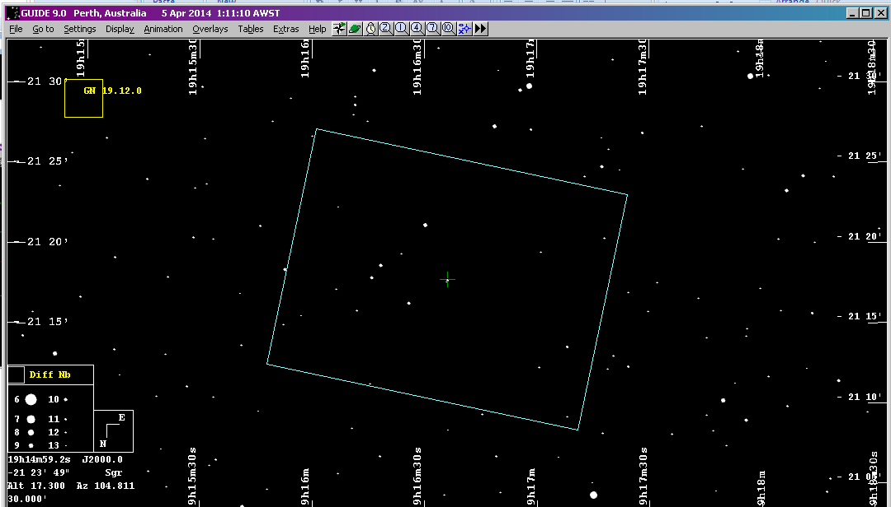
Know your field of view
Some programs will create an overlay
Notes:
Some charting software will create a field of view for you. This will give you an idea of the area your camera is looking at compared to the charts.
Over time you might start to get a feel for the level of detail you need for your particular set up and not need a guide but I would recommend making the effort in the beginning to speed up the identification process.

Slide 14
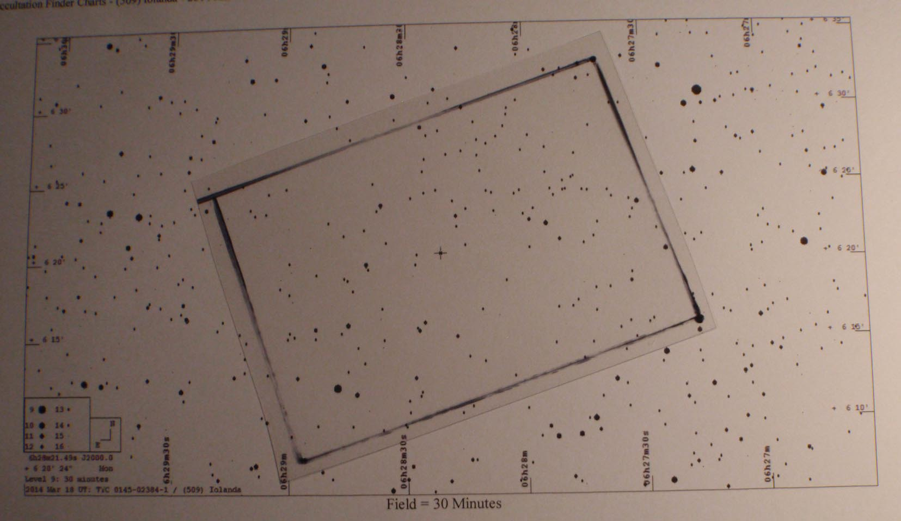
Know your field of view
Create a transparent overlay to act as a guide
Notes:
Alternatively you can hand draw an approximate guide on a transparency by roughly comparing the view on your screen to the chart you have for an easily recognisable area.

Slide 15
Give yourself plenty of time to find the target star
~30 minutes
(weather permitting)
Don’t assume that you will find it in a snap!
Notes:
Depending on your method, it may take some time to be sure you are in the right place. If you have clear skies I would recommend allowing at least 30 minutes prior to the beginning of recording to find your target star. This gives you time to make checks of the field of view and maybe even the adjacent stars as a double check, but also gives you time to watch what is happening regarding the seeing on the night and make adjustments to your integration level so that the target star is displaying at a steady brightness. If you get there in plenty of time – great! You can relax and enjoying what you’re doing.

Slide 16
Star hopping
Remember - Shortcuts don’t work!
Notes:
Star hopping a visual method where you start from a bright star and progressively “hop” along a series of stars, making little patterns amongst the stars as you go to guide you one, until you reach the target area. Remember, short cuts don’t tend to work, so don’t try to wing it and hope you’ll find the right spot.
An example of moving along a series of star patterns closer to the target star. Once you get closer to the target star check the patterns around it to make sure you know which star you are monitoring for the predicted event.

Slide 17
Goto techniques
Know your mount – be familiar with its set up routine and pointing accuracy
Point to the nearest bright star first before heading to the target star - smaller the jump, the more accurate it is likely to be
Work off the screen, not a reticule eyepiece
Notes:
Goto telescopes are all different and tend to have their own quirks. Using the mount regularly and becoming familiar with a pointing routine to refine its pointing accuracy is a good idea.
A useful technique is jump to the near bright star (eg one with a proper name) first before making a smaller jump to the target star. The smaller the slew distance the more likely it is to be accurate.
Also consider using the screen as a guide, not a reticule eyepiece. This will train the mount to point where you are actually looking and should increase the accuracy as well.

Slide 18
Pre-pointing techniques
Obtain a list of suitable pre-point stars through Occult , or
Apply tick marks to charts (such as Guide or C2A)
Prepare chart(s) to assist in accurate pointing
Point the scope at the appropriate time and leave
If you have an equatorial drive you could alternatively:
Point the telescope at the appropriate declination
Turn off the drive and wait for the target star to drift in
Restart the drive and track the star to event time
Notes:
Pre-pointing is pointing a non-tracking telescope at a bright star well ahead of event time and then waiting for the rotation of the Earth to carry the target star into the field of view at the right time. This is a common technique for remote stations, but you can use it in your backyard as well. To do this you need to either create a pre-point track in some charting software, such as Guide or C2A, or generate a list of candidate stars in Occult.

Slide 19
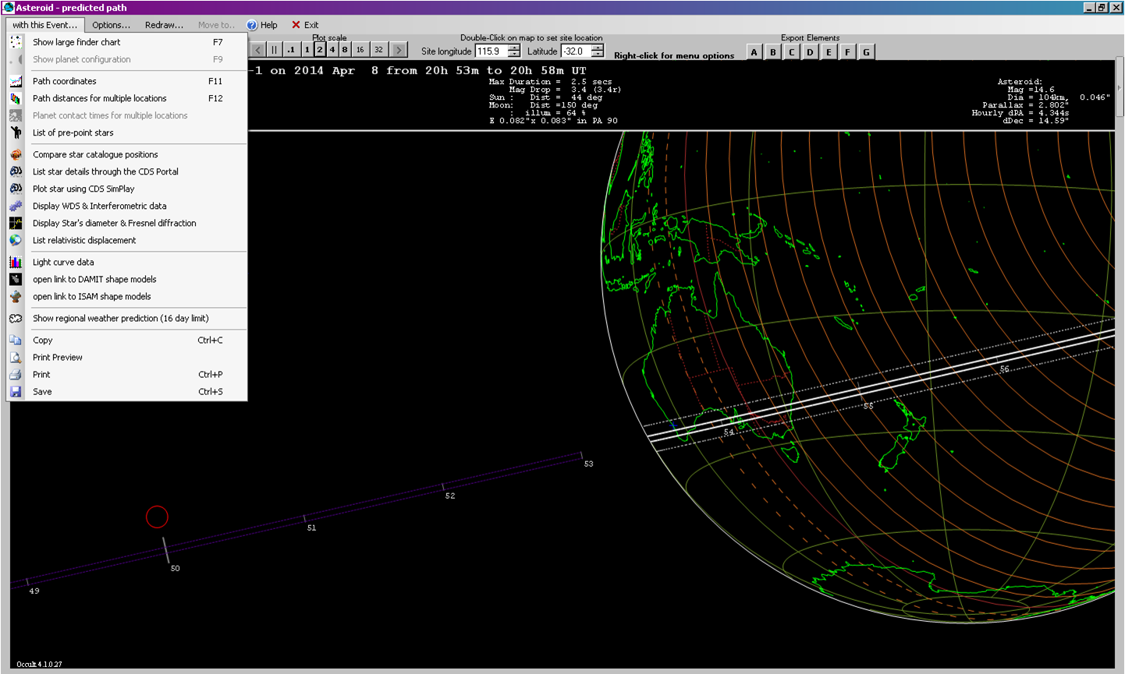
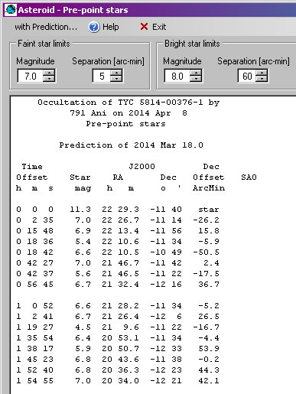
Generating a pre-point list in Occult
Notes:
If you have a world map up for a particular event you can go to the top left corner of the map and choose “List of Pre-point stars” from the drop-down menu “With this Event…”
To get a world map you have to first generate a list of predictions for that day or asteroid and then display them – double clicking on an event line should bring the world map up. This brings up a list of candidates for you to choose from. You can filter the list for brightness. Choose a star that is relatively bright and as close to the centre line as possible (e.g. it has the smallest offset.)

Slide 20
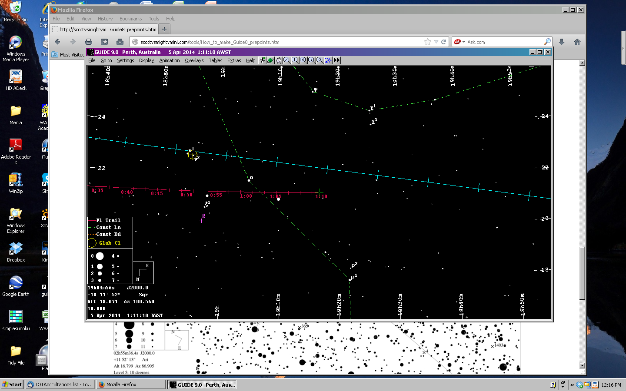
Generate a pre-point track on a chart
http://scottysmightymini.com/tools/How_to_make_Guide8_prepoints.htm
Notes:
Some software, such as C2A and Guide, will assist you in generating a pre-point track on your chart. This example is from Guide and a good explanation of how to do this is given at http://scottysmightymini.com/tools/How_to_make_Guide8_prepoints.htm

Slide 21
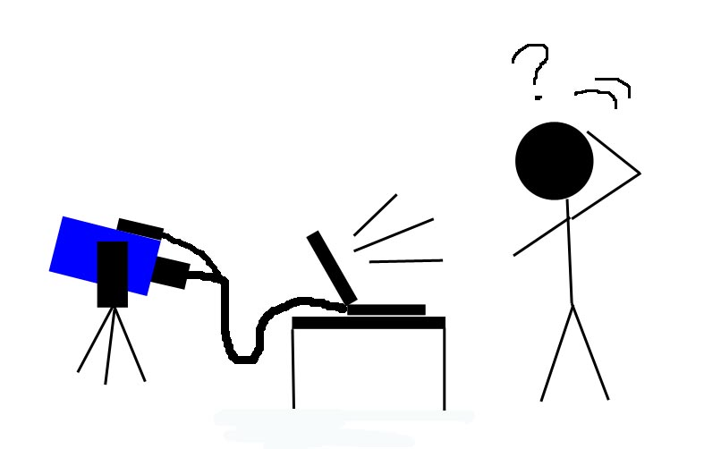
Look out for “double stars” in the wrong place
Hey, that’s a neat double star…but I don’t have one on the chart!
Notes:
This was me one evening last December…eventually I realised what was happening!

Slide 22
Take note!
Check the magnitudes of the target star and the asteroid – they may be very similar!
A low magnitude drop should also alert you to this situation
They may appear separate up to 15 minutes before the event – you should notice the distance closing over time
There may be a noticeable brightening of the target star (combined magnitude) around event time
Notes:
Sometimes the asteroids are almost as bright as the target star (and occasionally they are even brighter!). When this happens you should be able to see the asteroid approaching the star up to 15-20 minutes before hand (and afterwards as the asteroid moves on.) If you’re not prepared for this you may get confused by the extra “star” on the screen.
So it pays to do your homework and take note of the magnitude of the asteroid as well as the magnitude of the target star. A small drop in magnitude should also alert you to watch out for the presence of the asteroid on the screen.

Slide 23
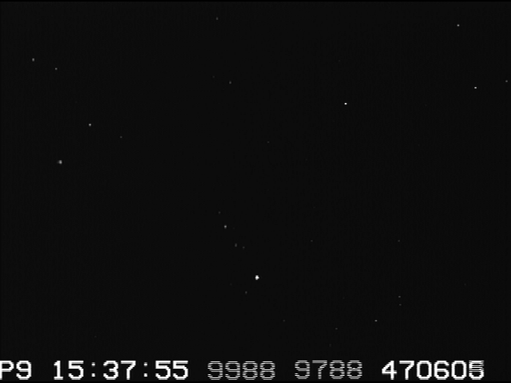
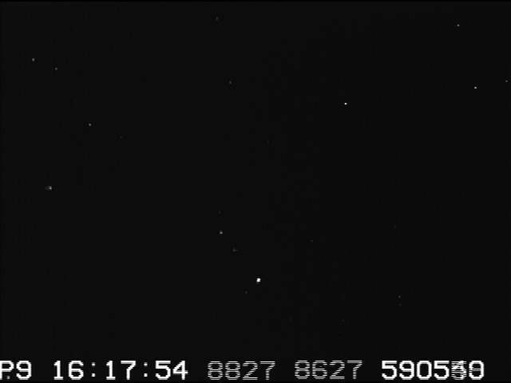
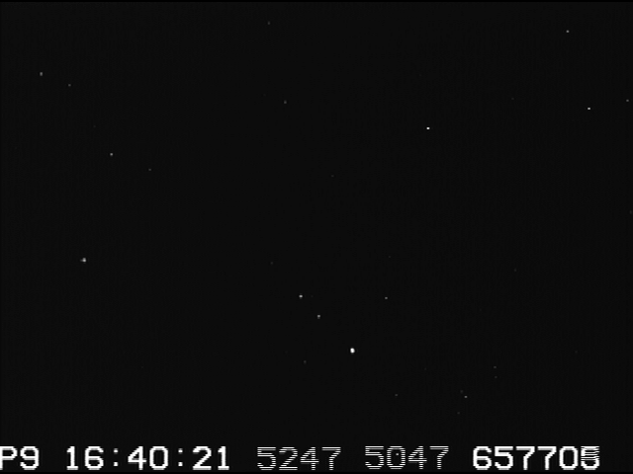
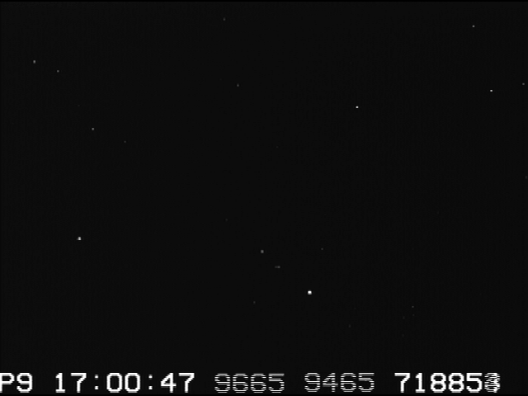
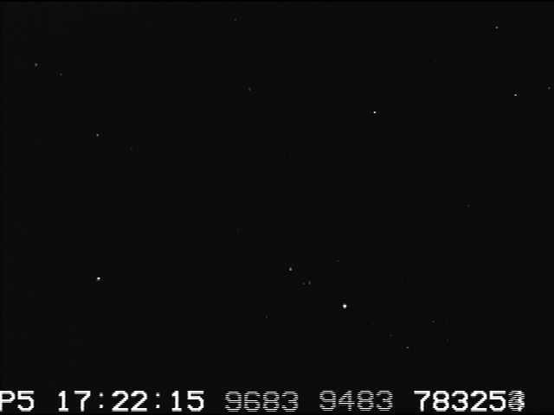
…just passing by…
Notes:
A short animation of an event where the asteroid was bright enough to be seen. On the right is the finder chart used. The video display has a number of hot pixels that look like stars, plus there are some fainter stars showing in the video that are not on the chart. As the animation progresses in the next slide you should see the asteroid move from lower right to top left of the target star. In this event an occultation was NOT seen, so it may be described as “monitoring an appulse.”

Slide 24
Keep a log of your settings until you become familiar with your set up
In Summary:
Spend some time preparing at the desk with reviewing the event data and preparing appropriate charts before heading outside
Notes:
Spend some time preparing: spending some time at the desk reviewing the details of the event and preparing the appropriate charts will help you be organised when you get outside with the telescope.
Keeping a log of your set up: With a range of settings available on an integrating camera it can be helpful to keep a log of what works when. As well as the settings on the camera consider noting variable details such as the magnitude of the target star, its altitude, the phase of the Moon and how far away it might have been.

Slide 25
Practise!
Practise!
Practise!
Notes:
This old saying is very appropriate for occultation observers. The more you get out under the stars and practise the easier it will become. You will probably develop your own method based on your individual telescope set up and your individual way of thinking. There is no right or wrong way to find the target star, but I hope the methods I’ve outlined today assist you in finding the star you need with the minimum amount of fuss.

